Slide 1
Hello..!

Slide 2
Self Introduction
I am Meet Vaghela.
I belongs to Rajkot.
I Came here For Set My Career and get Stable Life.
I am Too much Silent type person, because of Fear.
Can not easily Express my emotions.

Slide 3

I Like
Playing Piano
Listening Music Specific Peacefull Music, Calm Music like Arijit Singh’s Songs.
Cooking
Walk in Nature
Swimming

Slide 4

I Hate
So Much Crowd
Hip-Hop Type Music
Rudeness
Over Confidence me / Other
Too much Taking

Slide 5
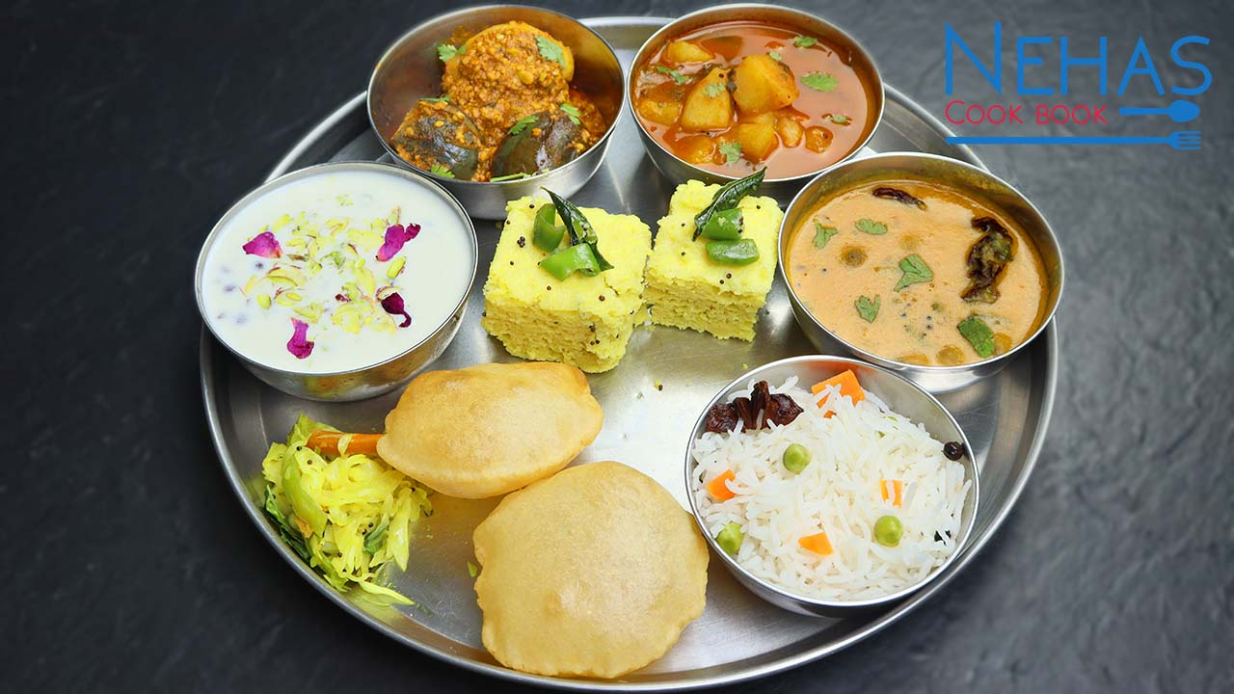
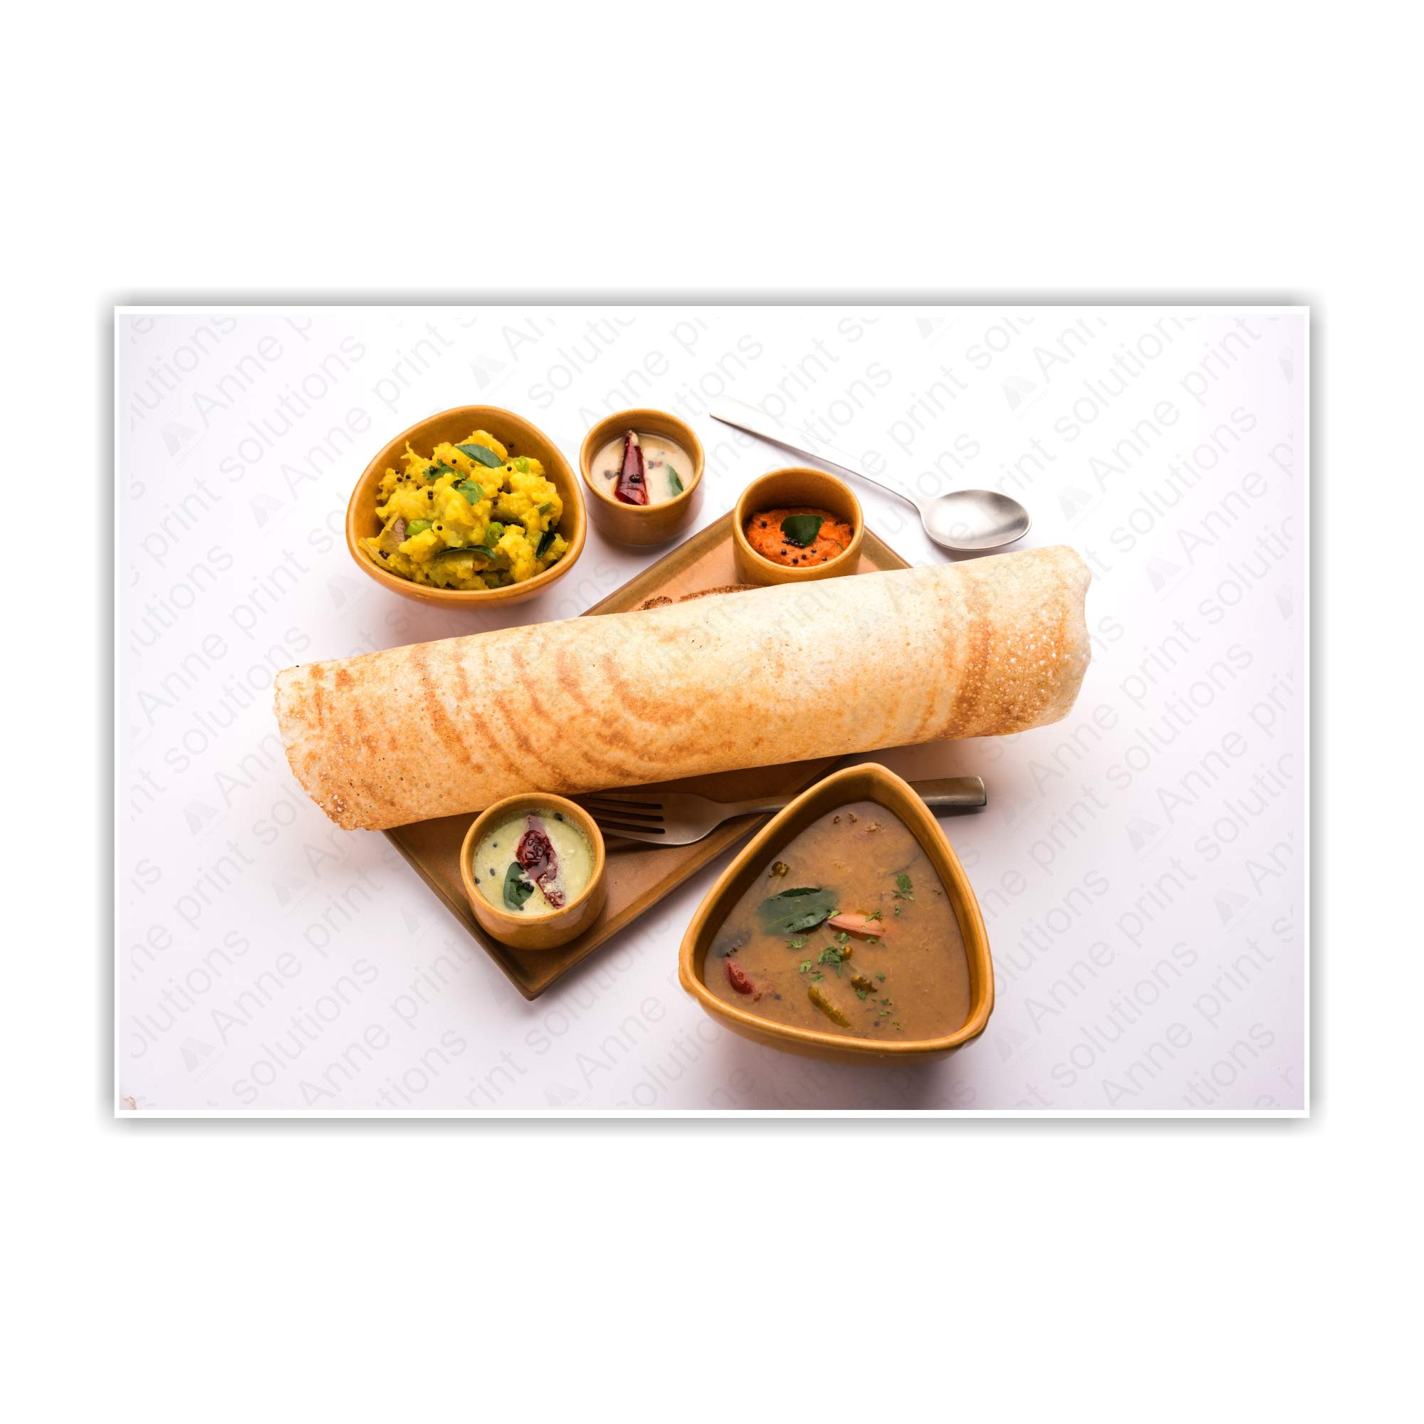

I LOVE
South Indian Food
Reading Books Like
History of Modern India
By- Bipin Chandra
Go out with Friends
Programming
Watch Suspensefull Movies

Slide 6
SWOT Analysis
STRENGTHS:
Focused
Supportive Family
Motivated
WEAKNESS:
Trouble in saying ‘NO’
Sometimes lack Confidance
Difficulty in asking for help
THREATS:
Express My Self
Inner Fear
Sometimes lack of Knowledge
OPPERTUNITIES:
Good Position at work
Growth in IT Field

Slide 7
Belief System
I Believe in , If You Trust Yourself Anything is Possible. Be Positive , Be Calm, Accept Situation And Keep Smilling in Life.
Thank You .

